Slide 1
Which inputs carry the model?
CS2 round win-probability model · 6 November 2026
An 83-input model, explained, and tested group by group on the team's metric, GDT.
Notes:
Short version of the explainability report. The paper-format report has the method, all tables and the caveats.

Slide 2
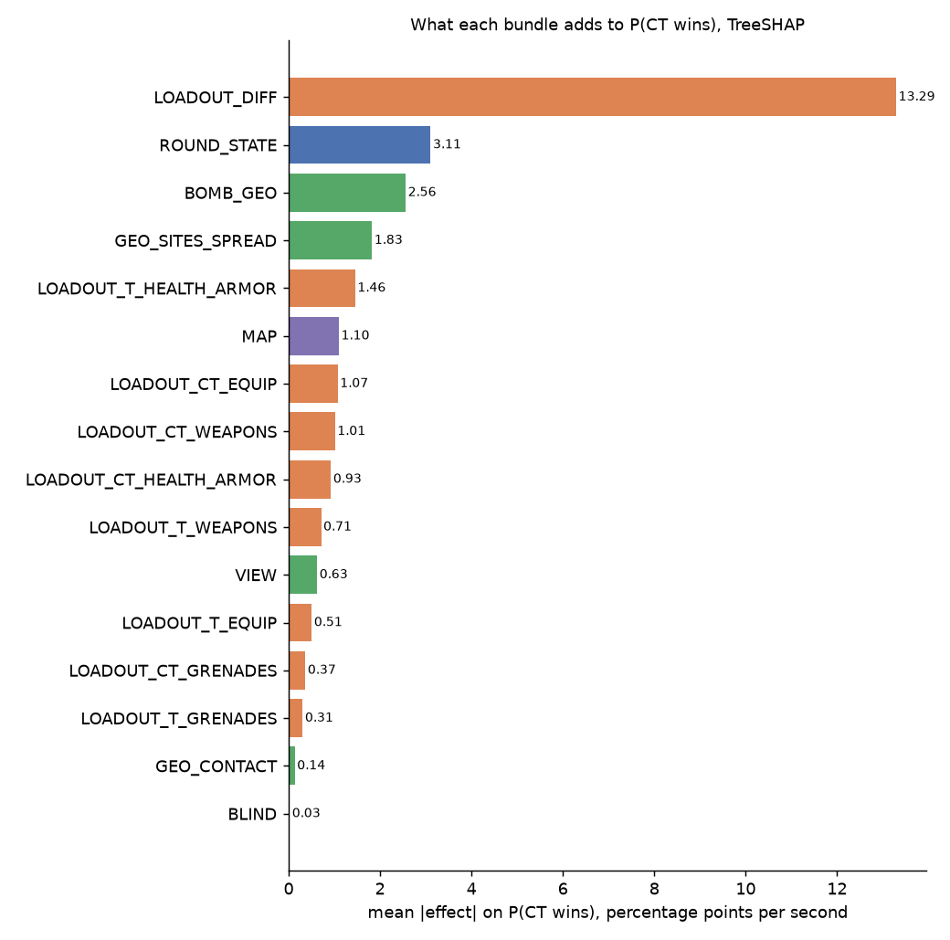
Loadout carries most of the signal
13.3
points per second from the loadout difference (CT minus T)
3.1
points per second from round state (alive counts, bomb, clock)
3.5
points in total from the 24 position inputs
Mean absolute TreeSHAP effect on P(CT wins), validation sample. Source: explainability report, Table 2.
Notes:
Loadout means each side's equipment, weapons, armour and health. Round state and position are smaller but real. The position total is across 24 inputs, not one.

Slide 3
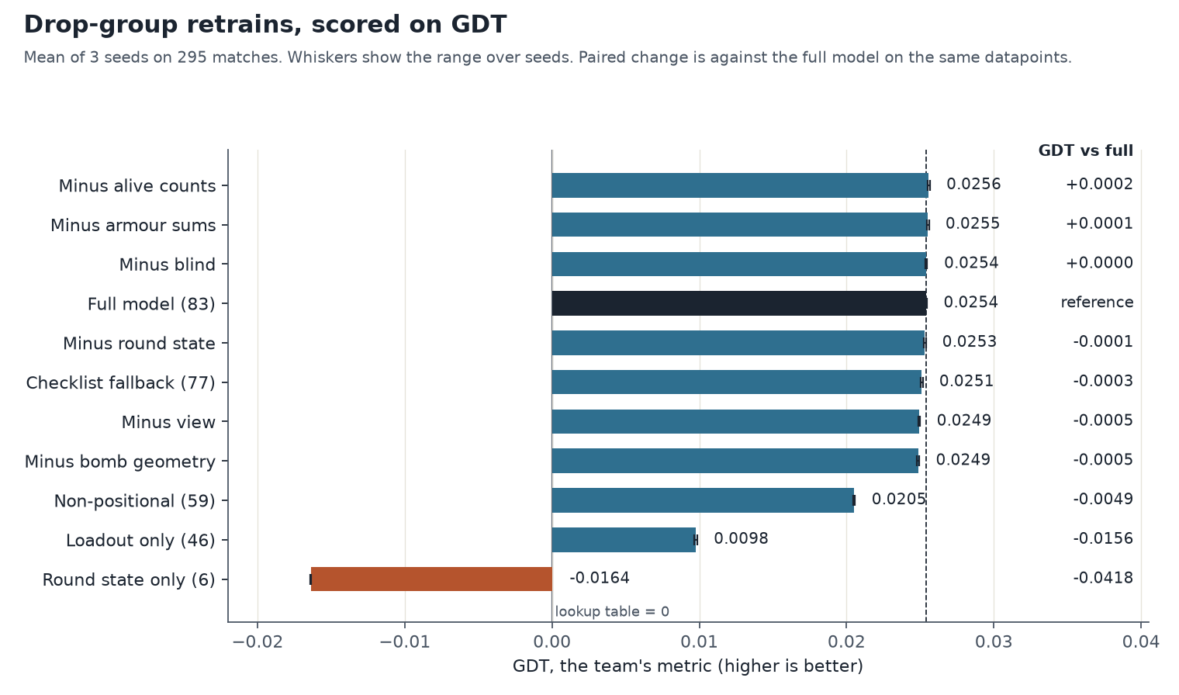
On GDT, loadout is most of the model
GDT, the team's metric, on 295 matches. Mean of three seeds; whiskers show the range over seeds. Bars below zero are worse than the lookup table.
Notes:
GDT is the gain over the team's lookup table. The full model scores 0.0254. Loadout alone scores 0.0098. Round state alone scores below the table.

Slide 4
83 or 77: the 83 wins on both measures, narrowly
Model | Inputs | GDT | GDT vs full | Log loss vs full
Full model | 83 | 0.0254 | reference | reference
Checklist fallback: no armour sums, no VIEW | 77 | 0.0251 | −0.0003 | +0.00028
Minus round state | 77 | 0.0253 | −0.0001 (noise) | +0.00083
Non-positional: no position inputs | 59 | 0.0205 | −0.0049 | +0.00343
The fallback is worse in every seed on both measures. Minus round state is within seed noise on GDT, but log loss prefers the 83 in every seed.
Same fit path and split for every row. GDT and log loss are means of three seeds; changes are paired with the full model on the same seed.
Notes:
Two different 77-input sets. The checklist fallback removes the armour sums and the VIEW inputs. Minus round state removes the six round-state inputs. Neither changes the decision by much; the 83 is kept because it is better on both measures.

Slide 5
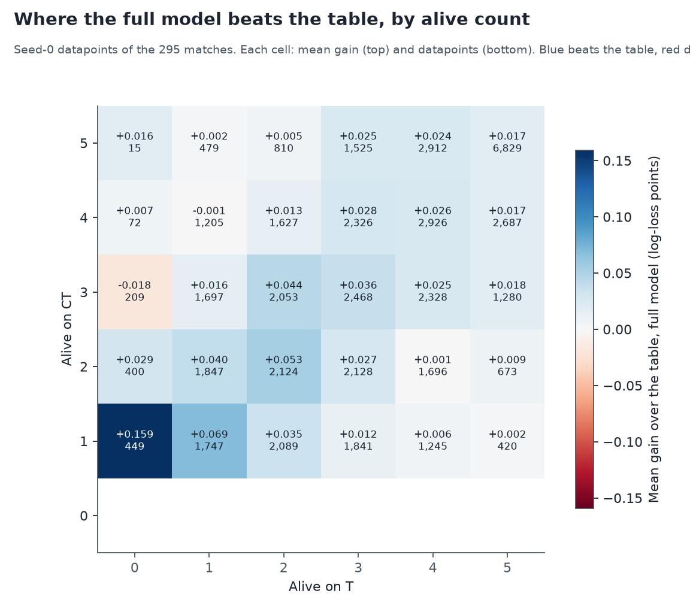
The full model beats the table in 78% of matches
78%
of the 295 matches have a positive gain over the lookup table
+0.024
median gain per sampled datapoint in a match
Blue cells beat the table; red cells do worse. Rows are alive CT, columns alive T.
Seed-0 sampled datapoints from the team's scorer. Each cell shows its mean gain and its datapoint count.
Notes:
The gain is the table's log loss minus the model's, per sampled datapoint. 28 of the 30 alive-count cells are positive. The two red cells hold 3% of the datapoints.

Slide 6
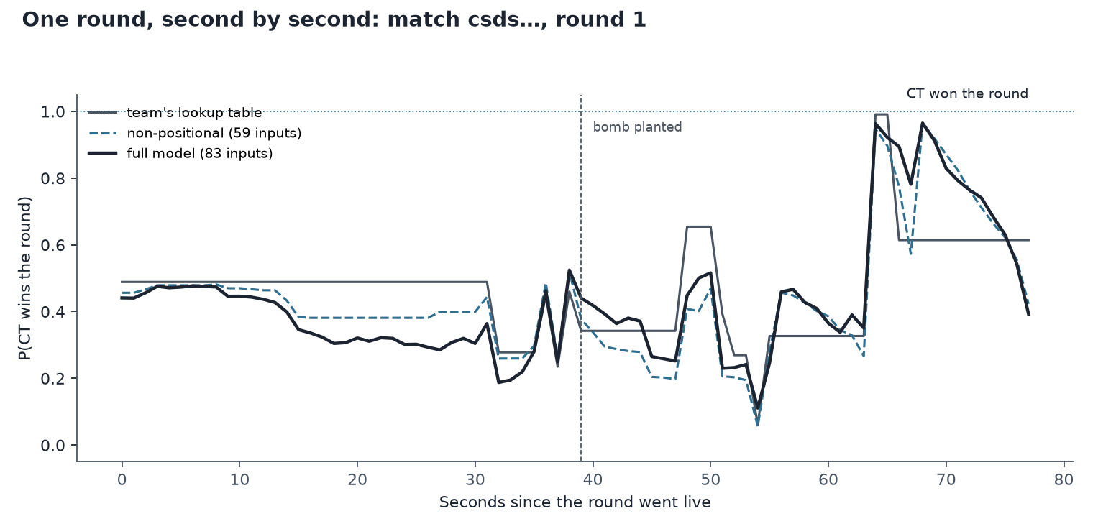
One round, second by second
Match of 22 September 2026 (m_ea00dba4…), the match where the position inputs help most on GDT. Table, non-positional model and full model; the dotted line is the outcome.
Notes:
This is one round from one match, picked by a fixed rule: the match where the full model gains most over the non-positional model. It illustrates the mechanism, not an average.

Slide 7
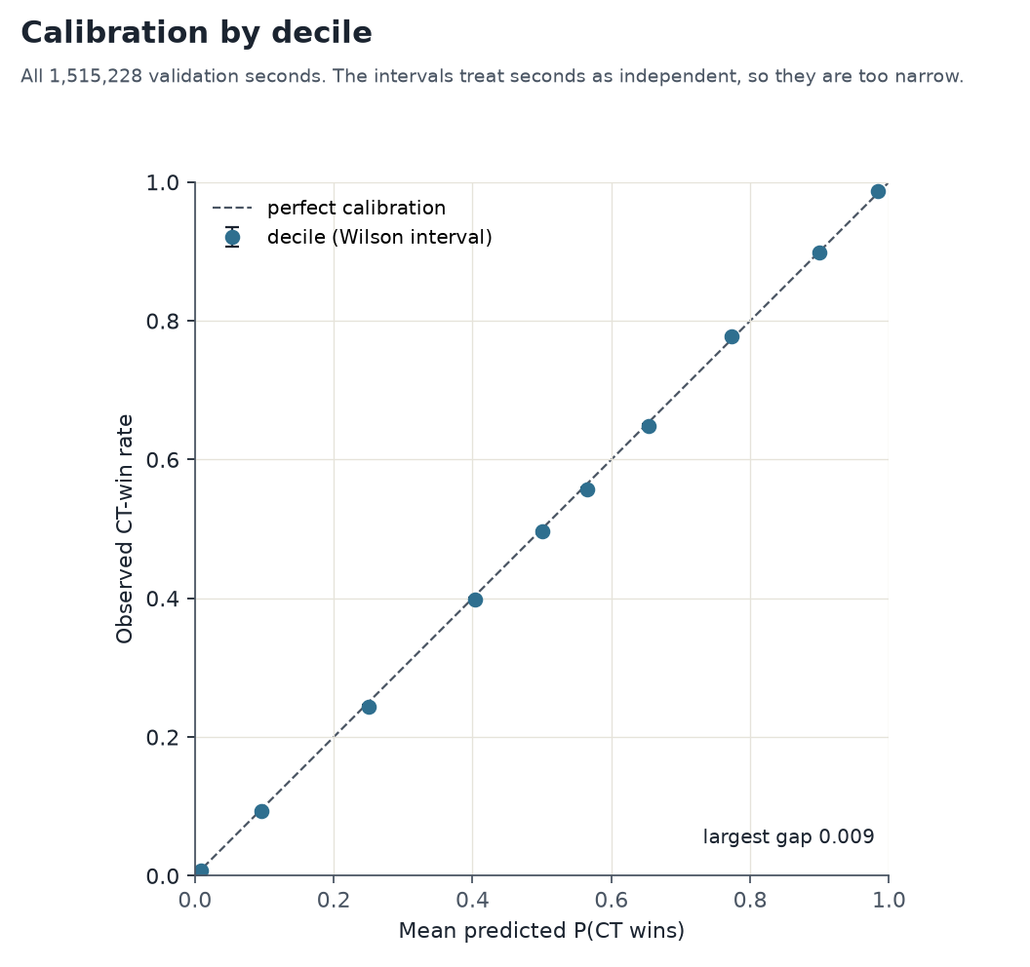
The model is calibrated over 1.5 million seconds
0.009
largest gap between predicted and observed CT-win rate, in any decile
1.48 vs 1
CT round wins expected against observed, over 1,033 rounds in 1-versus-5 states
Shipped booster on all 1,515,228 validation seconds. Wilson intervals treat seconds as independent, so they are too narrow.
Notes:
Calibration is checked two ways: per second, in deciles, and per round in the 1-versus-5 state, because seconds in one round share an outcome.

Slide 8
Next steps
Site and spread is the largest position group. On its own it costs 0.002 GDT, and contact costs nothing measurable. The single-group drops sum to about 0.003, against 0.005 for all 24 together, so the groups overlap. Rebuild site and spread first.
Rebuild the flagged inputs. VIEW, BLIND and defuse slack, then retest each group on GDT.
Train on a GDT-matched weighting. Equalise each round's situations, to see whether the 83-vs-77 choice changes.
Regenerate the design matrix from the raw tomes, and check it against the current one.
Detailed report: XGB_explainability_report.docx in docs/explainability. Nothing here is committed or pushed.
Notes:
The first two are measurement and cleanup. The third is a modelling experiment. The fourth is needed before anyone can reproduce the matrix from raw data.

